Slide 1
Applied Physics(C. Sc.) BS CS Semester-I Course Code: L-14(Laws of Reflection, Refraction and Total Internal Reflection.) IUB & All Affiliated Colleges. Reality Awards Boost Up (YT-Channel)
Rushmat Ali
Assistant Professor OF Physics
Govt. Kh. F. Graduate College R. Y. Khan

Slide 2
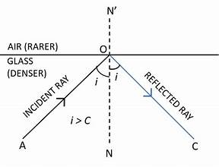
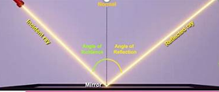
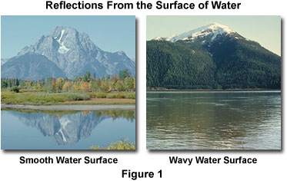
Reflection:
The bouncing back of something when it is travelling in one medium, strikes the boundary of another medium, is called Reflection.
Physics is the study of matter and energy. Reflection takes place for both material body or energy wave.
Example: A cricket ball struck to wall bounces back in same medium. Similarly, Light or sound waves are reflected from interface of medium.
Reflection of waves: Echo and image formation by mirror are examples of reflection of waves.
Reflection of Light: When light rays are incident from one medium(air) to and another medium(Mirror), the rays are bounced back, is called Reflection of light.
Explanation: Consider a ray (AO) is coming from a source of light, travelling in air is incident on a smooth mirror at point O, making angle <i with normal as in figure.
The ray striking mirror bounces in the same medium and takes the path ray(OC) as in figure.
Any surface from which reflection takes place is called mirror.
Line drawn perpendicular to mirror is called normal, represented by ON=ON’
The ray of light striking mirror from source is called is called Incident Ray(AO)
The ray bounced from mirror is called Reflected Ray(OC).
The angle between incident ray and normal is called Angle of incident <i. The angle between reflected ray and normal is called angle of reflection. <r

Slide 3


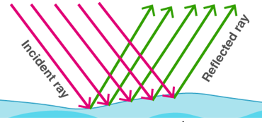
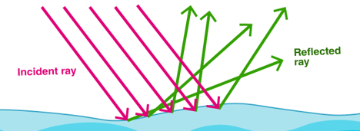
Reflection of Light:
Any surface from which reflection takes place is called mirror.
Line drawn perpendicular to mirror is called normal, represented by ON=ON’
The ray of light striking mirror from source is called is called Incident Ray(AO)
The ray bounced from mirror is called Reflected Ray(OC).
The angle between incident ray and normal is called Angle of incident <i. The angle between reflected ray and normal is called angle of reflection. <r
Laws of Reflection of Light:
The laws of reflection determine the reflection of incident light rays on reflecting surfaces, like mirrors, smooth metal surfaces and clear water. Let’s consider a plane mirror as shown in the figure above. The law of reflection states that
The incident ray, the reflected ray and the normal all lie in the same plane
The angle of incidence = Angle of reflection

Slide 4
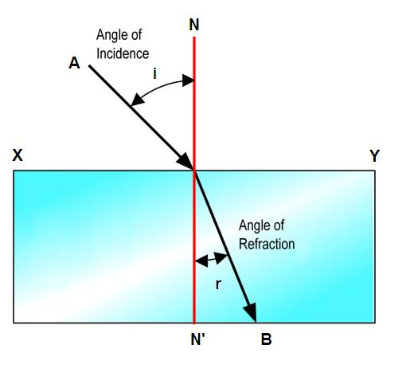
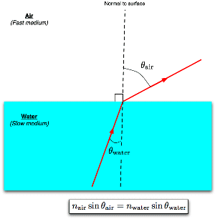
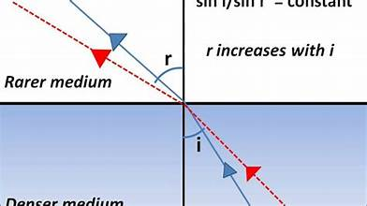
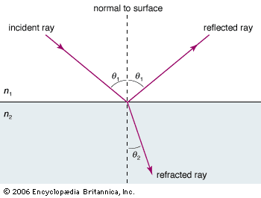
Refraction of Light:
The bending of light or change in velocity(magnitude + direction) of a wave passing from one medium to another is called refraction of wave(light).
When light travels from air(Rare medium) to glass/water(Denser medium), it bends towards normal and when it travels from denser to rare medium, it bends away from normal
For example, waves travel faster in deep water than in shallow.
If an ocean wave approaches a beach obliquely, the part of the wave farther from the beach will move faster than the part closer in, and so the wave will swing around until it moves in a direction perpendicular to the shore line.
A straight stick appears bent when partly immersed in water and viewed at an angle to the surface other than 90°.

Slide 5
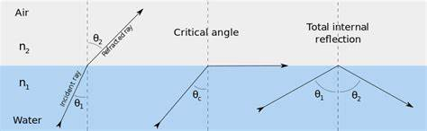
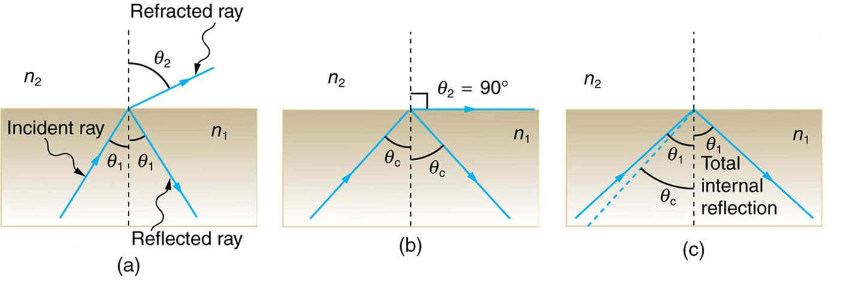
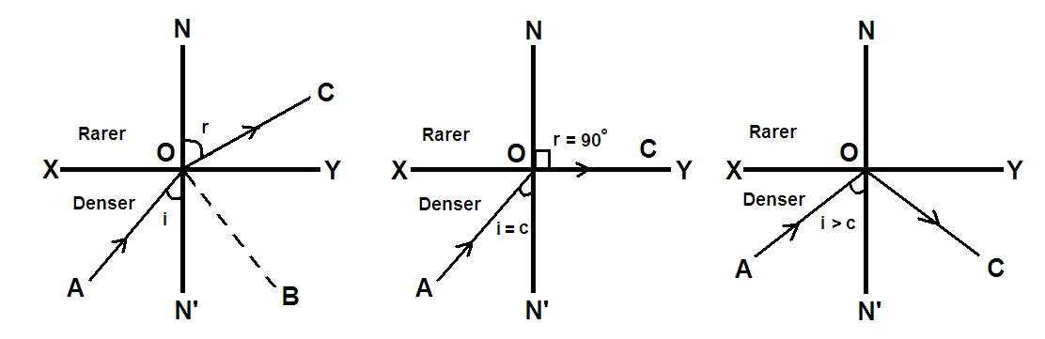
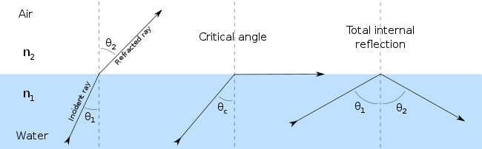
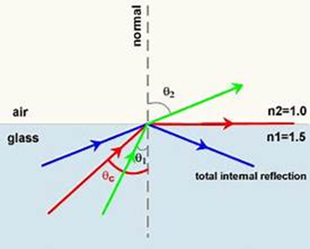
Total Internal Reflection:

